Slide 1
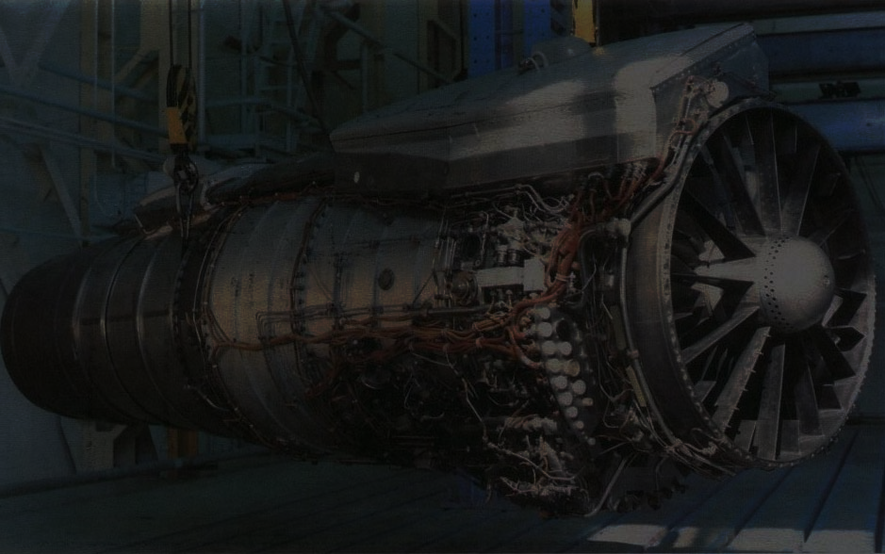
CRYOGENIC ENGINES
T.V.VIGNESH
VII Semester, Section A,
B.E. Electrical & Electronics
Reg.100906133
Roll. 69

Slide 2

CONTENTS
INTRODUCTION
HISTORY
SCENARIO
PRINCIPLE & WORKING
APPLICATIONS
ADVANTAGES
DISADVANTAGES

Slide 3

INTRODUCTION
Cryogenics
Some Cryogenic fuels
Cryogenic Engines
Difference from Electric Motors
Characteristics
Notes:
Kyros meaning cold Genes meaning produced
Cryogenics is the study of the production and behaviour of materials at very low temperatures
A cryogenic rocket engine is an engine that uses a cryogenic fuel or oxidizer (or both) which are gases liquefied and stored at very low temperatures.
Fuels-liguid hydrogen as fuel and liquid oxygen as oxidizer
Difference- no rotating part. Reaction machines
Characteristics -

Slide 4

HISTORY
First Cryogenic Rocket Engine
USA in 1963
Next in the line..
Japanese LE-5 engine flew in 1977 ,French HM-7 in 1979 , Chinese YF-73 in 1984, Soviet Union in 1987
INDIA
First Engine in 2008
Notes:
The United States was the first country to develop cryogenic rocket engines with RL-10 engines, registered its first successful flight in 1963 and is still used on the Atlas V rocket.
Then The Japanese LE-5 engine flew in 1977 ,French HM-7 in 1979 , Chinese YF-73 in 1984 .
The Soviet Union, first country to put a satellite and later a human in space, successfully launched a rocket with a cryogenic engine only in 1987.

Slide 5

SCENARIO
GSLV & Cryogenic Engines
ISRO’s Weakness
Foreign Collaborations
Notes:
At present, ISRO's PSLV launchers are used to propel satellites up to two tonnes. The GSLV Mark-III will carry four tonnes, and once the technology is perfected, the new launchers would be able to ferry up to 20 tonnes.
20 year wait.. Spy interference
Noone sharing technology

Slide 6

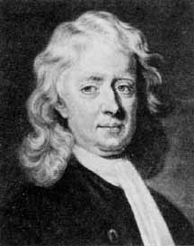
PRINCIPLE & WORKING
Newton’s Laws
Force is equal to change in momentum per change in time. For constant mass, force equals mass times acceleration
Every object remains at rest or in uniform motion in a straight line unless compelled to change its state by the action of an external force.
For every action (force) in nature there is an equal and opposite re-action.

Slide 7
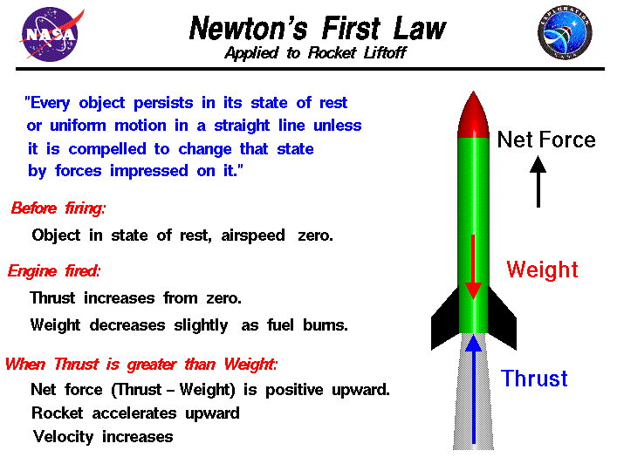
PRINCIPLE & WORKING

Slide 8
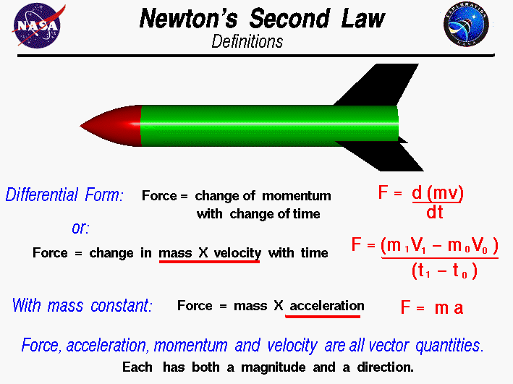
PRINCIPLE & WORKING

Slide 9
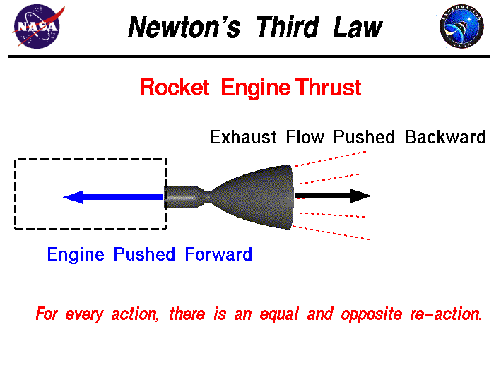
PRINCIPLE & WORKING

Slide 10
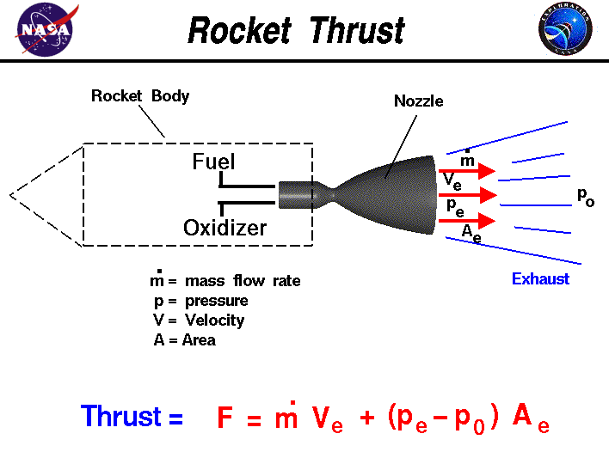
PRINCIPLE & WORKING
Notes:
m is the rate of the ejected mass flow, P₀ the pressure of the ambient atmosphere, P_{e} the pressure of the exhaust gases and V_{e} their ejection speed. Thrust is specified either at sea level or in a vacuum.

Slide 11
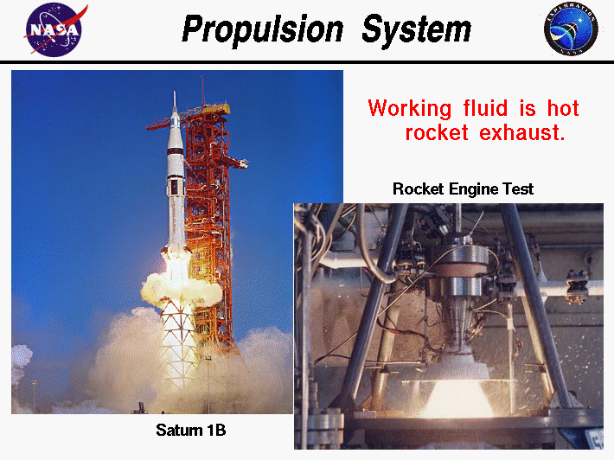
PRINCIPLE & WORKING

Slide 12
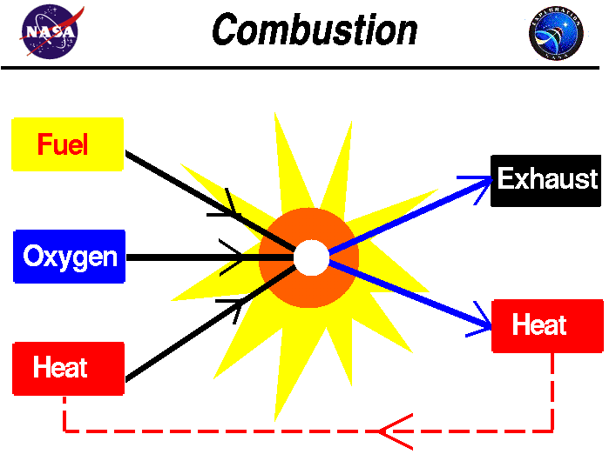
PRINCIPLE & WORKING

Slide 13
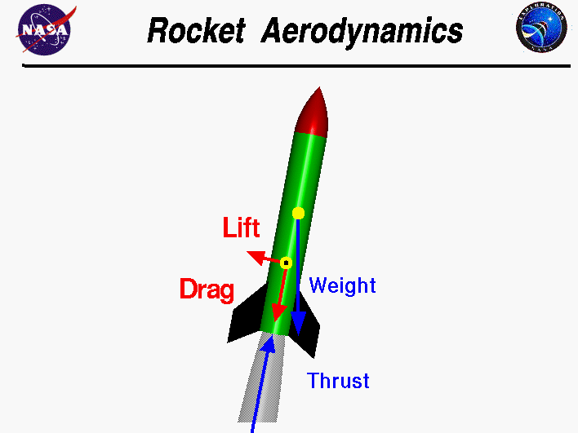
PRINCIPLE & WORKING

Slide 14
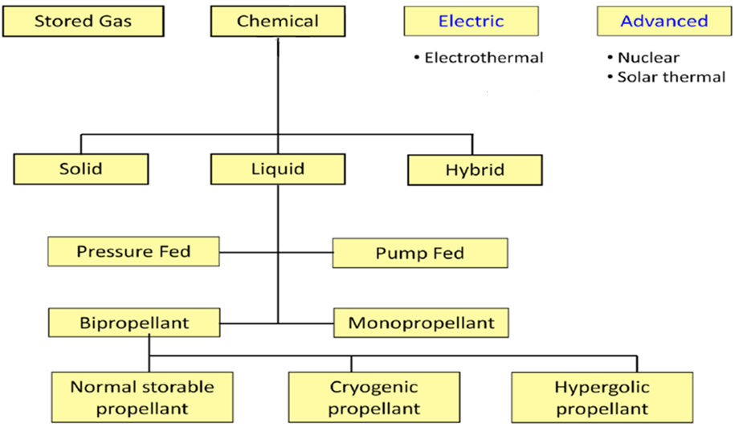
CLASSIFICATION OF SPACE PROPULSION SYSTEMS

Slide 15
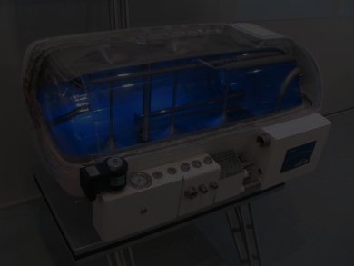
CRYOGENIC FUELS
Cryogenic propellant - the fuel and the oxidizer
Super cooled gases -temperature lower than the freezing point.
To store them is difficult task
Cooling and compressing them into liquids, we can vastly increase their density and make it possible to store them in large quantities in smaller tanks.
Nitrogen, hydrogen, oxygen, helium argon, neon, etc,
Liquid oxygen being the oxidizer and liquid hydrogen being the fuel.
Liquid oxygen boils at 297ºF and liquid hydrogen boils at 423ºF.

Slide 16
COMPONENTS OF CRYOGENIC ROCKET ENGINE
Thrust chamber or combustion chamber
Igniter
Fuel injector
Fuel turbo-pumps
Valves
Regulators
Fuel tanks
Rocket engine
Nozzle

Slide 17
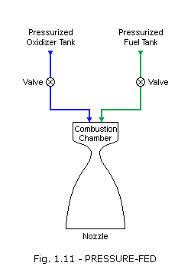
ROCKET ENGINE POWER CYCLES
PRESSURE FED CYCLE
Notes:
The simplest system, the pressure-fed cycle, does not have pumps or turbines but instead relies on tank pressure to feed the propellants into the main chamber. In practice, the cycle is limited to relatively low chamber pressures because higher pressures make the vehicle tanks too heavy. The cycle can be reliable, given its reduced part count and complexity compared with other systems.

Slide 18
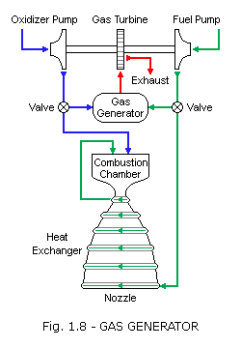
ROCKET ENGINE POWER CYCLES
GAS GENERATOR CYCLE
Notes:
The gas-generator cycle, also called open cycle, taps off a small amount of fuel and oxidizer from the main flow (typically 2 to 7 percent) to feed a burner called a gas generator. The hot gas from this generator passes through a turbine to generate power for the pumps that send propellants to the combustion chamber. The hot gas is then either dumped overboard or sent into the main nozzle downstream. Increasing the flow of propellants into the gas generator increases the speed of the turbine, which increases the flow of propellants into the main combustion chamber, and hence, the amount of thrust produced. The gas generator must burn propellants at a less-than-optimal mixture ratio to keep the temperature low for the turbine blades. Thus, the cycle is appropriate for moderate power requirements but not high-power systems, which would have to divert a large portion of the main flow to the less efficient gas-generator flow.
As in most rocket engines, some of the propellant in a gas generator cycle is used to cool the nozzle and combustion chamber, increasing efficiency and allowing higher engine temperature.

Slide 19
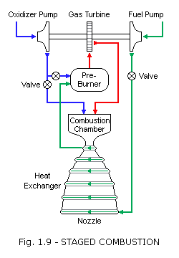
ROCKET ENGINE POWER CYCLES
STAGED COMBUSTION CYCLE
Notes:
In a staged combustion cycle, also called closed cycle, the propellants are burned in stages. Like the gas-generator cycle, this cycle also has a burner, called a preburner, to generate gas for a turbine. The preburner taps off and burns a small amount of one propellant and a large amount of the other, producing an oxidizer-rich or fuel-rich hot gas mixture that is mostly unburned vaporized propellant. This hot gas is then passed through the turbine, injected into the main chamber, and burned again with the remaining propellants. The advantage over the gas-generator cycle is that all of the propellants are burned at the optimal mixture ratio in the main chamber and no flow is dumped overboard. The staged combustion cycle is often used for high-power applications. The higher the chamber pressure, the smaller and lighter the engine can be to produce the same thrust. Development cost for this cycle is higher because the high pressures complicate the development process. Further disadvantages are harsh turbine conditions, high temperature piping required to carry hot gases, and a very complicated feedback and control design.
Staged combustion was invented by Soviet engineers and first appeared in 1960. In the West, the first laboratory staged combustion test engine was built in Germany in 1963.

Slide 20
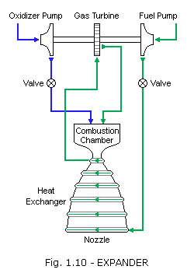
ROCKET ENGINE POWER CYCLES
EXPANDER CYCLE
Notes:
The expander cycle is similar to the staged combustion cycle but has no preburner. Heat in the cooling jacket of the main combustion chamber serves to vaporize the fuel. The fuel vapor is then passed through the turbine and injected into the main chamber to burn with the oxidizer. This cycle works with fuels such as hydrogen or methane, which have a low boiling point and can be vaporized easily. As with the staged combustion cycle, all of the propellants are burned at the optimal mixture ratio in the main chamber, and typically no flow is dumped overboard; however, the heat transfer to the fuel limits the power available to the turbine, making this cycle appropriate for small to midsize engines. A variation of the system is the open, or bleed, expander cycle, which uses only a portion of the fuel to drive the turbine. In this variation, the turbine exhaust is dumped overboard to ambient pressure to increase the turbine pressure ratio and power output. This can achieve higher chamber pressures than the closed expander cycle although at lower efficiency because of the overboard flow.

Slide 21
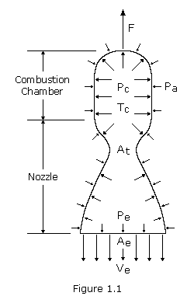
COMBUSTION IN THRUST CHAMBER
Notes:
shows a combustion chamber with an opening, the nozzle, through which gas can escape. The pressure distribution within the chamber is asymmetric; that is, inside the chamber the pressure varies little, but near the nozzle it decreases somewhat. The force due to gas pressure on the bottom of the chamber is not compensated for from the outside. The resultant force F due to the internal and external pressure difference, the thrust, is opposite to the direction of the gas jet. It pushes the chamber upwards.
P_{c} the pressure inside combustion chamber, P_{e} the pressure of the exhaust gases and V_{e} their ejection speed. At is area of junction, Pa is atmospheric pressure, Tc is thrust in combustion chamber

Slide 22
OTHER APPLICATIONS OF CRYOGENICS
Liquification of gases
Food industry for preservation
Medical fields for High resolution MRI

Slide 23

ADVANTAGES
High Energy Per Unit Mass
Clean Fuels
Economical

Slide 24

DISADVANTAGES
Highly Reactive gases
Leakage Problems
Hydrogen Embrittlement
Zero Gravity Condition

Slide 25

CONCLUSION
Notes:
The area of Cryogenics in Cryogenic Rocket Engines is a vast one.
Developments in the field of Rocket Engineering.
Cryo propelled rocket engines are having a great demand in the field of space exploration.
Due to the high specific impulse obtained during the ignition of fuels they are of much demand.

Slide 26

THANK YOU…
ANY QUESTIONS?

